Slide 1
Introduction to Digital Humanities

Slide 2
Course Topics
Digital Humanities: A History
Anatomy of DH Projects
Archives: Endangered, Lost, Banned, Censored Books (visit to Thomas Fischer Rare Book Library)
How to Read with DH Data: Zoom In, Zoom Out, Tell Stories, Play Games
Interfaces, Users, and Usability
Communities, Libraries, and Possible Futures

Slide 3
Learning Goals
Digital Humanities (DH) is a discipline at the intersections of the humanities with computing.
Digital humanists analyze languages through digital text collections; build digital archives of forbidden books; resurrect historical cities through digital maps; or construct video games to study literature.
This year the course focuses on endangered books: fragile, hidden, censored, forbidden. We speak to scholars who build archives of forbidden literature. We visit the Thomas Fisher Rare Book Library. We study rare books’ histories through digital exhibits.
By the end of the course, you will have mastered concepts and technologies you can use in future courses and workplaces: data visualization, data analysis, and digital exhibit platforms. And you will learn how our stories and cultural conversations work and shapeshift through digital environments.

Slide 4
By the end of the course:
You will be able to describe the history and intellectual landscape of the digital humanities, including central concepts, debates, digital tools and platforms current in the discipline.
You will be able to analyze digital humanities research projects across a variety of humanities disciplines
You will have developed critical thinking and a set of best practices around data modeling, datasets, project design and management, and research data management
You will have analyzed and built visualizations and digital maps
You will have researched and authored your own digital exhibit

Slide 5
WDW235 Student (September-December 2018)
Designed, researched, and built a searchable digital collection of multimedia documents and a public-facing digital exhibit about censored books
Through research, field visits, and role-playing scenarios, acquired working knowledge of data management challenges and data curation best practices
Through hands-on workshops, gained familiarity with content management systems such as Omeka and data visualization platforms such as Tableau, Palladio, and Voyant.

Slide 6
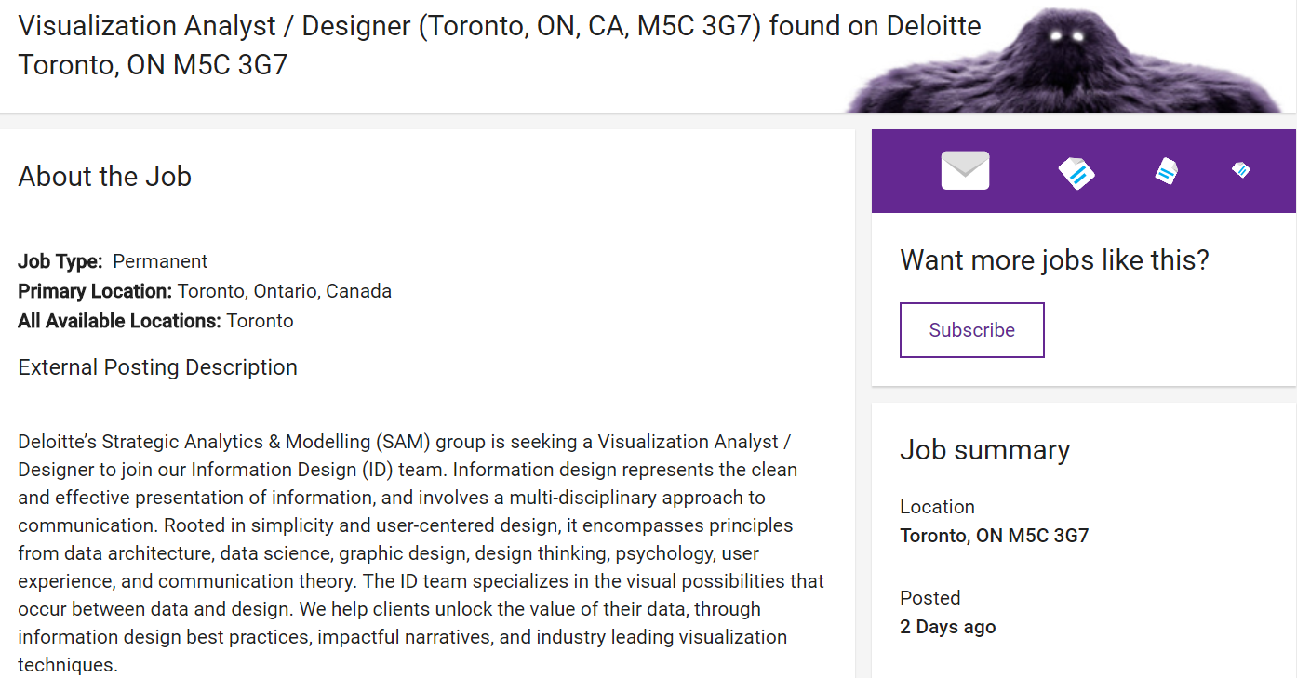

Slide 7
Job Requirements
WDW235H1F
Brainstorming solutions to complex business problems through working sessions, wireframing and developing mockups
Developing static infographics and/or interactive data visualizations, that adhere to Information Design best practices, and effectively communicate business insights back to clients
Working through iterative cycles, incorporating feedback and completing user testing and QA
Collaborating extensively with clients and other Deloitte teams
Liaising with data science and data architecture team members to optimize client data for visualization purposes
Managing project timelines and client deliverables
Completed a major digital exhibit project, from research with banned books from rare book collection, to public-facing digital exhibit about censorship and knowledge transmission
Developed static infographics and an interactive digital exhibit using open-source, high-uptake technologies, adhering to data management best practices, and effectively communicating original artifact analyses to public audiences
Worked through iterative cycles, from proposal pitch to mock-up development, incorporating feedback at each stage
Managed project timelines and multiple deliverables

Slide 8
Qualifications
WDW235H1F
• Candidates with experience creating static or interactive visualizations for Financial Services Industry (FSI), Public Sector, or Customer/Marketing sectors are preferred
• University / college degree, preferably within the disciplines of graphic design, statistics, mathematics, or computer science
• Experience in the application of Information Design best practices to create static or interactive visualizations for client deliverables
• Experience with iterative development and agile competencies
• Ability to work conceptually and solve problems through white-boarding and creating mockups
• Strong presentation and communication skills to convey ideas and solutions to various target groups in both business and technology sectors
•Good working knowledge of data visualization software: Tableau/QlikView/PowerBI
Completed course work in Digital Humanities (computing + communication + humanities analytics)
Built and analyzed data visualizations based on open-source data from library and cultural heritage sector
Built major research project through iterative development
Workshopped analyses of digital research projects and data management challenges through white-boarding, mock-ups, and role-play
Good working knowledge of data visualization software: Tableau (multi-faceted data visualization for complex quantitative data); Palladio (web-based dataviz platform, including e.g. maps and network graphs); Cytoscape (bioinformatics platform for exploring relational data); Voyant (text corpus exploration)

Slide 9
One New Thing

